Slide 1
Civil War Spies & their Contributions
By: Mariana, Lexi & Loz

Slide 2
Table of contents
Table of contents
01
03
04
Spies
Books & diaries
02
04
Contributors
Pictures
05
Summary

Slide 3
01
Spies & Background

Slide 4
Rose Greenhow:
Ross O’Neal Greenhow
Birth= 1804
Died= October 1st, 1864
Rose wrote cipered (secret note) messages to the confederates provided information about the Union Military Plans.
Rose died by drowning, she was drowned when the boat capsized near Fort Fisher, North Carolina, The weight of the gold dragged her down
Rose was asked by Lieutenant Colonel Thomas to get information on the Union Military Plans
By: Mariana

Slide 5
Belle Boyd
Maria Isabella Boyd
Birth: 1844
Died: June 11 1900
Boyd would use her flirtatious skills and flirt with the union officers so that they would give her private information
In 1900 Belle Boyd went on a speaking tour in Wisconsin and went into cardiac arrest. Which she unfortunately passed away from a heart attack
Her last words were “I thank God that I can say on my deathbed that I am a virtuous woman.”
By: Lexi & Mariana

Slide 6
Sarah Edmonds
Sarah Emma Edmonds
Born: 1841
Edmonds liked to go by Franklin Thompson
Sarah Edmonds was an American Soldier who fought in the war disguised as a man
Edmonds liked to go by Franklin Thompson
Edmonds escaped an abusive father and an abusive marriage
When she moved to Michigan in 1856 she discovered life was easier disguise as a man
Edmonds died due to a severe case of Malaria she contracted when she was 56
Edmonds was also a field nurse, mail carrier and soldier
By: Mariana

Slide 7
Timothy Webster
Born: March 12, 1822
Died: April 29, 1862
Webster was a British-Born American Lawyer who served as a Pinkerton (american independent police force) agent and union spy
WEBSTER WAS THE FIRST SPY TO BE EXECUTED*
Confederate officials hung Webster at Camp Lee at Richmond Virginia
Webster was hung because he was found guilty of espionage
By: Mariana

Slide 8
02
Contributions

Slide 9
Rose Greenhow
Contributions
Greenhow was recruited as a confederate spy.
In July 1861 she secured and forward the movements of General Irvin
McDowell’s army toward Manassas Junction, Virginia.
Wrote encrypted messages to confederates and told them about the
Unions military plans.
She was credited with helping the South win the First Battle of Bull Run.
At the Old Capitol Prison, Rose sent encrypted messages and collected secret information.
By: Loz

Slide 10
Belle Boyd
Boyd in July of 1861, she shot and killed a young union officer that attempted to raise a flag over her residence earning herself as a souther celebrity.
Collected intelligence about Union Army forces.
Passing the information to a Confederate named Thomas Jackson who was a general during his 1862 Valley Campaign.
She also operated as a courier between Jackson and other Confederate commanders.
Got information from flirting and seducing men.
Boyd ran through a storm of bullets firing to tell Jackson that the Union was planning to demolish the bridge leading out to Front Royal.
By Loz

Slide 11
Timothy Webster
Timothy Webster
Uncovered a plot to assassinate the President elect of Abraham Lincoln in 1861.
A police officer
A pinkerton detective
Webster was a double agent that carried messages from confederate spies.
By Loz

Slide 12
Sarah Edmonds
Infiltrated the confederate army several times
A field nurse that dealt with multiple casualties.
By: Loz

Slide 13
03
Books & Diaries

Slide 14
Rose Greenhow’s Diary/Books
Had a diary throughout her missions and documented everything
Described her journey in great detail
Held in North Carolina State Archives in NC
Books:
Mrs. Greenhow. My imprisonment and the First Year of Abolition Rule at Washington
Halacy Dan. The Master Spy
Kinchen Oscar A. Women Who Spied for the Blue & the Gray
Mahoney M.H. Women in Espionage, A Biographical Dictionary
By: Lexi

Slide 15
Belle Boyd’s Books
Books written about her
Belle Boyd in camp and imprisoned
Lius II: Encounter
By: Lexi

Slide 16
Sarah Edmonds
She wrote in her diary the words “It is true I am not an American… not obliged to remain here during the terrible strife … But it is not my desire to seek personal ease and comfort while so much sorrow and distress fills the land.”
Books:
Nurse and spy in the Union Army
The Female Spy of the Union Army
By: Lexi

Slide 17
Pictures
04

Slide 18
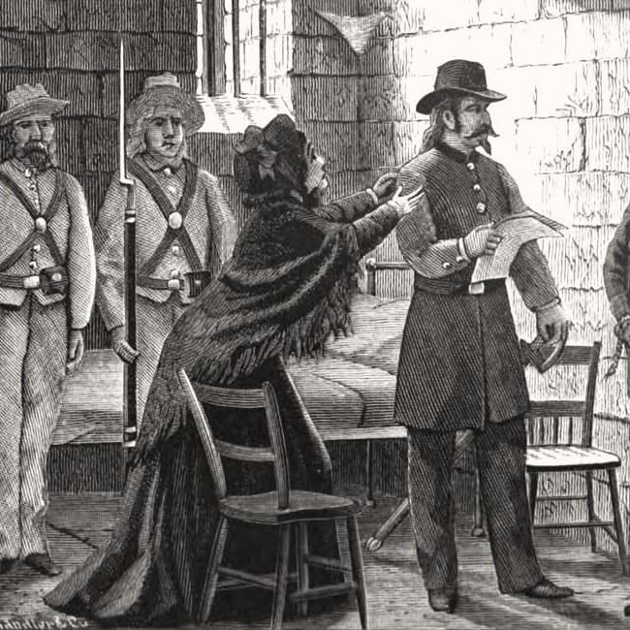
A picture Of Timothy Webster moments before hung
By: Mariana

Slide 19
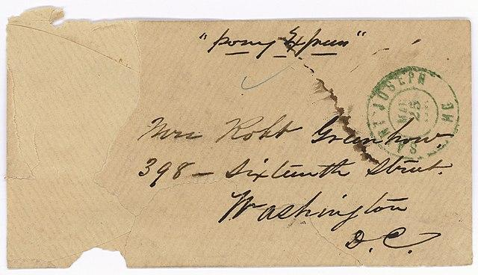
A Ciphered Note By Rose Greenhow
By: Mariana

Slide 20
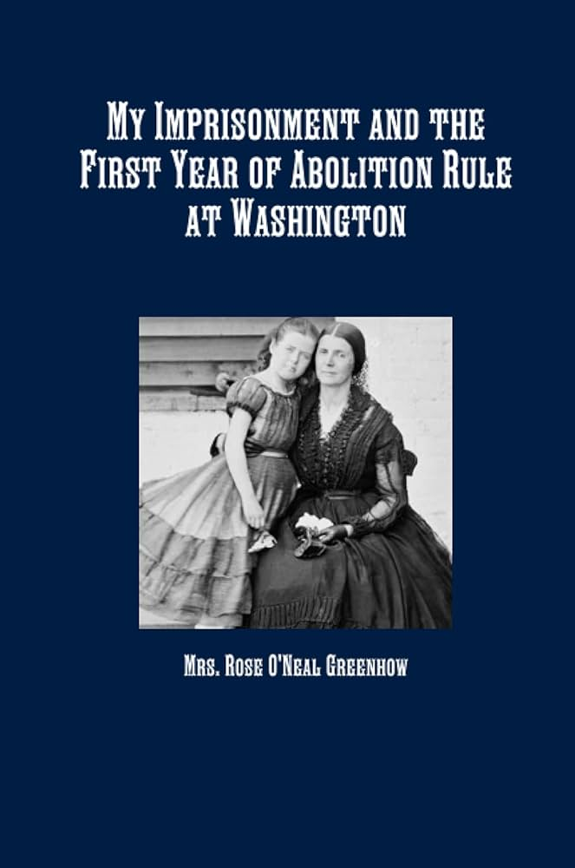
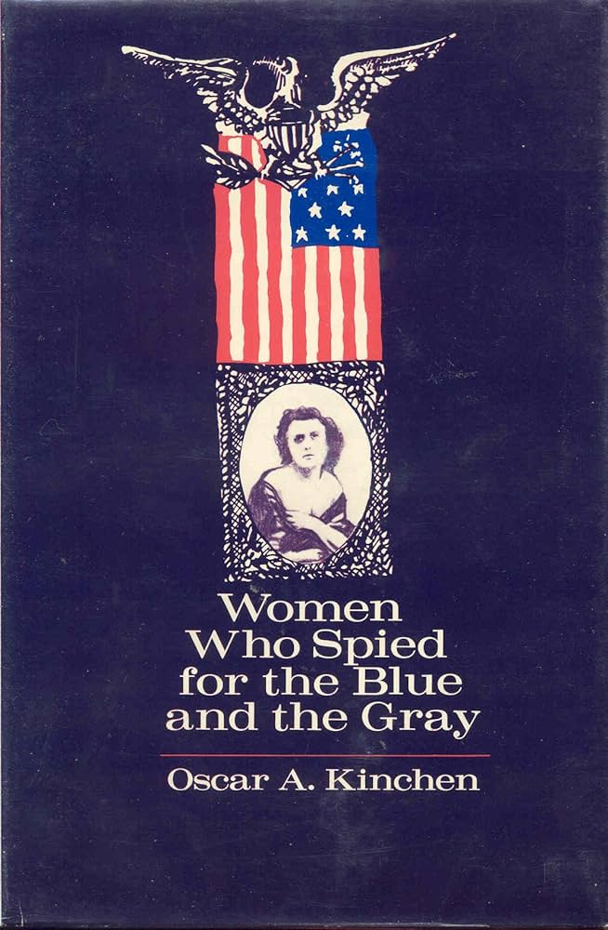
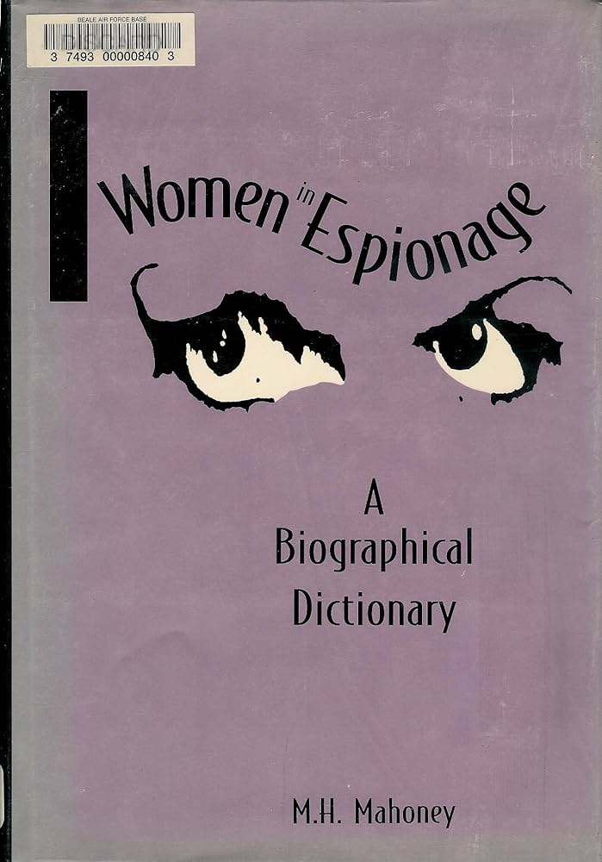
Rose Greenhouse’s Books:
By: Lexi

Slide 21
04
04
04
05
Summary/Conclusion

Slide 22
In conclusion, spies had a huge impact and role in the civil war, their magical and tough journeys and the ways they had to survive is what makes them interesting. Many books and diaries were written on them showing how inspirational they were to society. Each and every spy has something different about them that made their missions eventful and fascinating. Sarah Edmonds disguised herself as a man while Timothy Webster was the first spy to be executed, these little things is what makes these spies unique and important.
By: Lexi

Slide 23
Sources:
Belle Boyd: The Teenage Spy: “INTEL.gov”
https://www.intelligence.gov/evolution-of-espionage/civil-war/confederate-espionage/belle-boyd
Accessed: March 15, 2024
Rose O'Neal Greenhow Papers at Duke: “Duke University Libraries”
https://library.duke.edu/rubenstein/scriptorium/greenhow/
Accessed: March 20, 2024
“Wikipedia”
https://www.ipl.org/essay/The-Contributions-Of-Timothy-Webster-During-The-551BE0597C951B2C#google_vignette
Accessed: March 20, 2024
Seized Correspondence of Rose O'Neal Greenhow: “National Archives |”
https://www.archives.gov/research/military/civil-war/greenhow
Published: July 22, 2019 Accessed: March 20, 2024
Portrait of Sarah Emma Edmonds: “American Battlefield Trust”
https://www.battlefields.org/learn/biographies/sarah-emma-edmonds
Accessed: March 20, 2024

